Slide 1


Ninja Tower The Art of Coding the Thrill in Gaming

Slide 2


Introduction
Unleash the power of Ninja Tower in gaming through advanced coding techniques. Dive into the world of game development and learn how to create thrilling experiences for players.

Slide 3
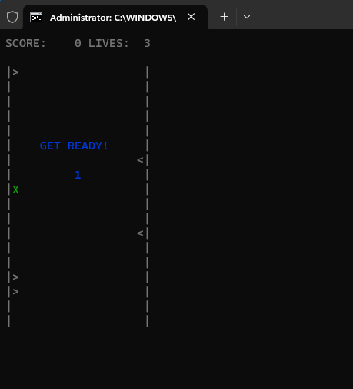
Key Features
Dynamic Wall Movement Spike Challenges
Score Tracking Immunity Period

Slide 4
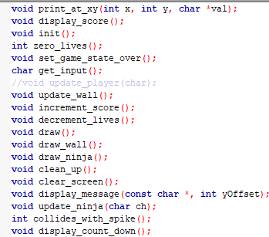
Code Overview
initialization Game Loops Graphics and Display
User input Collision Detection Countdown Display

Slide 5
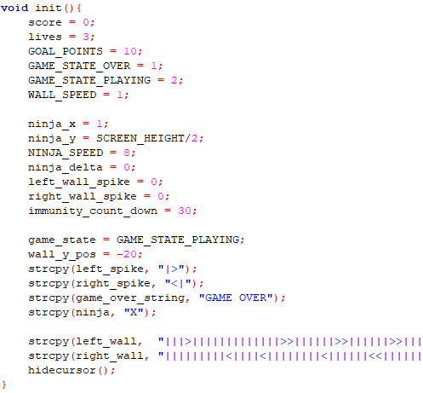
Initialization
Initializing Variables Setting Initaial State Hiding the Cursor

Slide 6
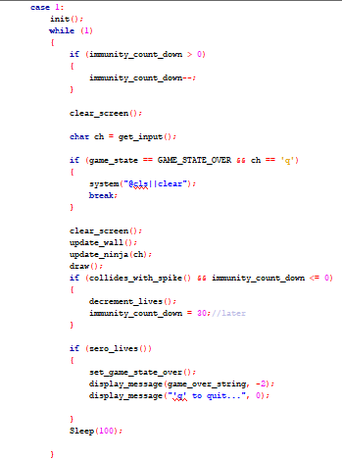
Game Loop
Processing Player Input Updating Game State

Slide 7
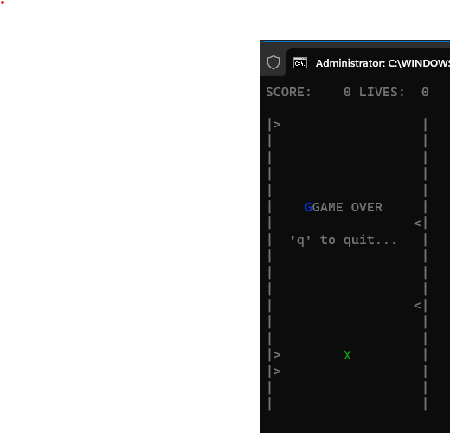
Graphics & Display
Dynamic String Printing
Real-Time Display

Slide 8
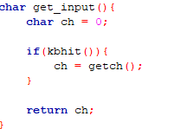
User Input
Kbhit()Function
Getch()Function

Slide 9
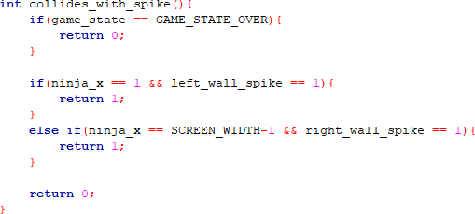
Detecting Collision Adjusting Score and Lives
Collision Detection

Slide 10
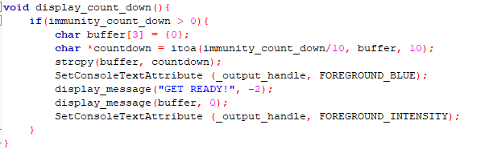
Countdown Display
Enhancing User Experience
Enhancing User Experience

Slide 11

Conclusion
NINJA Tower is a testament to the creativity and skill of the developer. It combines gameplay mechanics, graphics, and user interaction to create a delightful experience.

Slide 12

Thanks!
Do you have any questions?

